Slide 1
R Programming Course
Overview of BIG data
Overview of R
Introduction to R
Data Structures
Programming Concepts
Graphs
Predictive Modeling

Slide 2

R Programming Course
1.1 Introduction to BIG data

Slide 3
R Programming Course
1.1 Introduction to BIG data – continued
In Feb 2001, Doug Laney, an analyst with the Meta Group, publishes a research note titled “3D Data Management: Controlling Data volume, Velocity, and Variety.”
Big data is the capability to manage a huge volume of disparate data, at the right speed, and within the right time frame to allow real-time analysis and reaction.

Slide 4

R Programming Course
1.1 Introduction to BIG data - continued
Big data enables organizations to store, manage, and manipulate vast amounts of data at the right speed and at the right time to gain the right insights.
eBay.com uses two data warehouses at 7.5 petabytes and 40PB as well as a 40PB Hadoop cluster for research, customer recommendations, and merchandising.
http://www.itnews.com.au/News/342615,inside-ebay8217s-90pb-data-warehouse.aspx

Slide 5
R Programming Course
1.2 Defining BIG data
In 2012, Gartner defined BIG data as follows:
Big data is
high volume,
high velocity, and/or
high variety information assets
that require new forms of processing to
enable decision making,
insight discovery and
process optimization

Slide 6
R Programming Course
1.3 Characteristics of BIG data
Volume is about the quantity of data
Variety is about the category to which the data belongs to
Velocity is about the speed of data generation
Variability is about the inconsistency shown by the data
Veracity is about the quality of data
Complexity arises especially for large volumes from multiple sources
Volume
Variety
Velocity
Variability
Veracity
Complexity
Characteristics

Slide 7
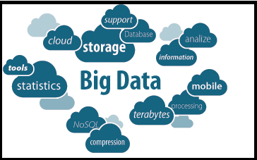
R Programming Course
1.4 Why BIG data?
Better management of data
Benefit from speed, capacity and scalability of cloud storage
Improvement in your data analysis methods
Explore new business opportunities
End users can visualize data

Slide 8
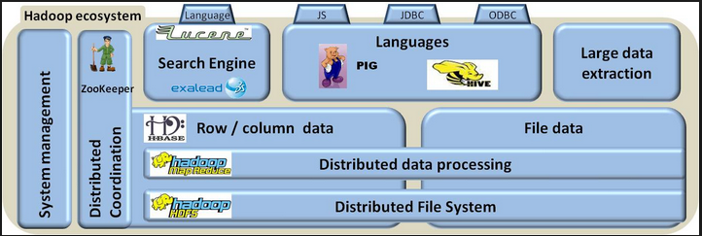
R Programming Course
1.5 Tools used in BIG data
1. Hadoop HDFS – The Hadoop Distributed File System (HDFS) is designed to store very large data sets reliably, and to stream those data sets at high bandwidth to user applications.

Slide 9
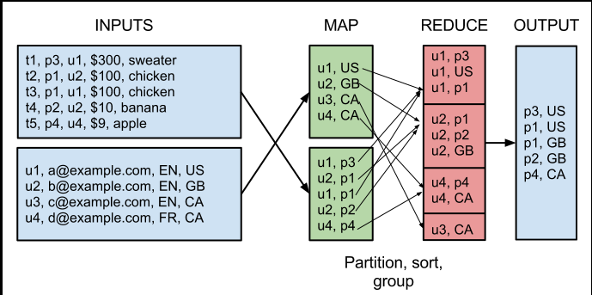

R Programming Course
1.5 Tools used in BIG data - continued
2. Hadoop mapReduce was designed by Google as a way of efficiently executing a set of functions against a large amount of data in batch mode.

Slide 10
R Programming Course
1.5 Tools used in BIG data - continued
2. MapReduce is designed for managing and processing big data; three major features:
Single and easy programming model
automatic and linear scalability and
built-in fault tolerance

Slide 11
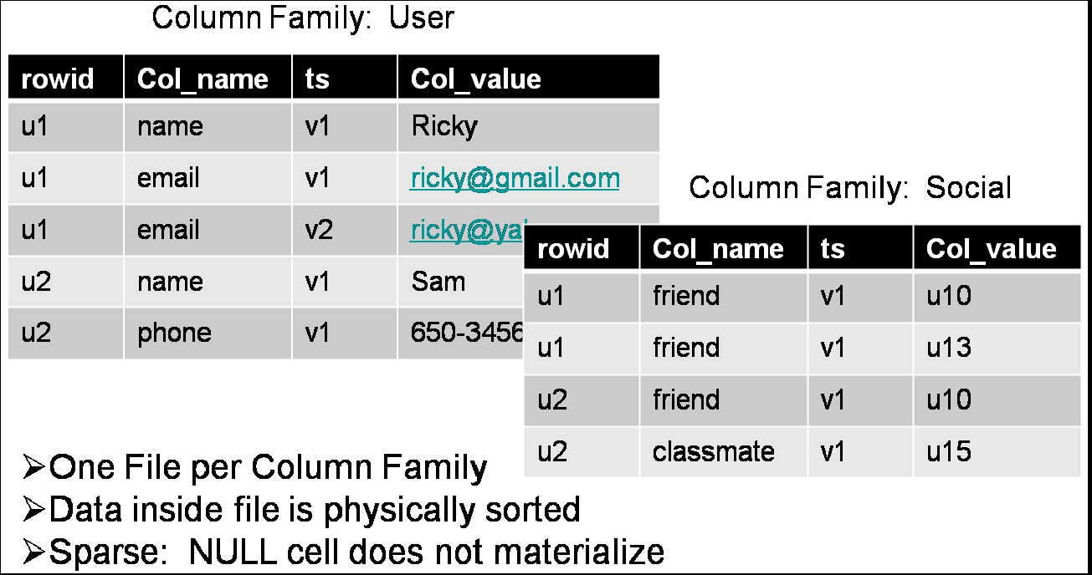

R Programming Course
1.5 Tools used in BIG data - continued
3. HBASE: is a distributed, non-relational (columnar) database that utilizes HDFS as its persistence store.

Slide 12
R Programming Course
1.5 Tools used in BIG data - continued
4a. PIG is an interactive, or script-based, execution environment supporting PIG Latin, a language used to express data flows.
4b. HIVE is a batch-oriented, batch-warehousing layer built on the core elements of Hadoop (HDFS and MapReduce).
It provides users who know SQL with a simple SQL-like implementation called HiveQL, without sacrificing access via mappers and reducers.

Slide 13


R Programming Course
1.5 Tools used in BIG data - continued
5. Search engine: Exalead's product, CloudView Solution is an infrastructure-level search and information access platform used for both online and enterprise Search-Based Applications (SBA) as well as enterprise search.
6. ZooKeeper: is a Hadoop’s way of coordinating all the elements of the distributed applications.

Slide 14


R Programming Course
1.6 Applications of BIG data
Healthcare
Evidence based Healthcare Models driven by "Health outcomes“
Provider & Staff shortage demands workforce productivity & Efficiency
c. Patient centered Care
d. Disease Management
Retail
Behavior profiling
Preference modeling
Affinity tracking
Brand Switching
Customer Loyalty
1/5/2015
2/13/2015
PVS
PVS
14
14

Slide 15

R Programming Course

Slide 16
R Programming Course
1) ________ is designed for managing and processing big data; three major features:
Single and easy programming model
automatic and linear scalability and
built-in fault tolerance
The missing word is:
a) HDFS
b) HBase
c) Zookeeper
d) MapReduce
HBASE is a distributed, ___________ database that utilizes HDFS as its persistence store.
The missing word is:
a) non-relational (columnar)
b) relational (row-based)
c) All of the above
d) None of the above

Slide 17
R Programming Course
3) MapReduce was devised by ___________ .
The missing word is:
a) Apple
b) Google
c) Microsoft
d) None of the above
Batch processing is used when
i) response time should be short
ii) data processing is to be carried out at periodic intervals
iii) transactions are in batches
iv) transactions do not occur periodically
a) i, ii
b) i, iii, iv
c) ii, iii
d) i, ii, iii

Slide 18
R Programming Course
ANSWERS
1) d) MapReduce is designed for managing and processing big data; three major features:
Single and easy programming model
automatic and linear scalability and
built-in fault tolerance
HBASE is a distributed, a) non-relational (columnar) database that utilizes HDFS as its persistence store.
MapReduce was devised by b) Google
Batch processing is used when
i) response time should be short
ii) data processing is to be carried out at periodic intervals
iii) transactions are in batches
iv) transactions do not occur periodically
c) ii, iii

